Slide 1
Language complexity and the semantic memory
University of applied science Darmstadt
Informationscience
Yannick Schladt
Content, examples and sources are based on the research book „Leichte Sprache – Einfache Sprache“ by Andreas Baumert

Slide 2
Table of contents
Complexity of language
Basic aspects
Measure language complexity
Flesch-Reading-Index
Requirements to understand a language
The semantic memory
Model
Schemes
Semantic Networks
Frames
Scripts

Slide 3
1 Complexity of language 1.1 Basic aspects 1.2 Measure language complexity 1.3 Reqiurements to understand a language
Phonology (Greece for „voice, loud“)
The usage of sounds in languages
Encoding loud systems of languages
Morphology
Analysing construction of words and its changes in different contexts
Syntax
Studies the structure of sentences
Semantic
Is about the meanings of words / expressions
Baumert, Andreas. (2016); Universität Bremen (no date)
Notes:
- Phono: How languages use particular louds to express something / Pre-condition to learn a language
*Application fields: Teaching a language, Spoke and speech disorders (f.e. Dyslexie)
- Morpho: analysing the smallest meanigfull unit of a word – unbreakable
- Syntax: studies the structure of sentences, Rules of how words build sentences, Not about the meaning or sense-
- Semantic: about the meaning of words and expressions/ what does someone or something mean in a certain context?

Slide 4
1 Complexity of language 1.1 Basic aspects 1.2 Measure language complexity 1.3 Reqiurements to understand a language
Content words vs. function words
„The higher the percentage of functionwords in a text the easier to understand it.“(Helmut Meier)
Flesch-Reading-Ease
Baumert, Andreas (2016); Ryte GmbH (no date)
Notes:
Content words: have an own meaning (nouns, verbs, adjectives, adverbs)
Function or structure words (article, pronouns, conjunctions etc.)
do mostly only have a sence when they are in a context with other words
- Helmut Meier: Ranking words in 14 levels of difficulty
FRE: ASL: average sentence length of a text
* ASW: Average number of syllables per word
* Exists also for german language
Another word factor because the average of the length of german words is higher

Slide 5
1 Complexity of language 1.1 Basic aspects 1.2 Measure language complexity 1.3 Reqiurements to understand a language
Cognitive competences and capacity
Understanding of senses and grammar
Ability to Categorise words and sentences
Attentiveness and endurance
Baumert, Andreas (2016)
Notes:
To relate words and sentences in different situations
to understand its sense and gramma
Categorise them to known

Slide 6
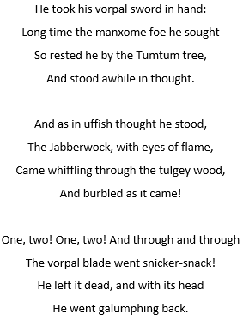
2 Semantic Memory 2.1 Model 2.2 Schemes 2.3 Semantic Networks 2.4 Frames 2.5 Scripts
Baumert, Andreas (2016), Caroll, Lewis (1871)
Notes:
Jabberwocky – no special meaning or deeper sense, wordcombinations, unknown words, experiences, we know which kind of word could follow wheater a verb or a noun f.e.
We can interpret detailed processes and relations
computers, programs and visualisation methods can help us with that
Nowadays scientist can look indirectly into brains
while someone is reading letters or characters
or when someone analyses a sentence and starts to give elements a meaning

Slide 7
2 Semantic Memory 2.1 Model 2.2 Schemes 2.3 Semantic Networks 2.4 Frames 2.5 Scripts
A human ability to read and understand texts
Requires factual and conceptual knowledge about the world
A way to understand / learn
Schemes -> Networking -> Frames -> Scripts
Baumert, Andreas (2016)
Notes:
article in a journal . headline we have already an idea of what the text could be. When we start to read a text – text ending prognose – sentence – sentence could end.
Ability bc we read many texts and maybe texts of the same topic. already information saved in our brain cache. That’s called semantic memory
contains models and schemes that are based on memories
To relate words and sentences in different situations
to understand its sense and gramma
Categorise them to known
Schemes: theoretical concept or imagination that we have of a matter including a personal review and it‘s execution
Networking: relate elements in our scheme with each other
Frames: like packages of knowledge that we can apply on a task
Scripts: short and concise keywords or even phrases to give a quick overview over the matter

Slide 8
2 Semantic Memory 2.1 Model 2.2 Schemes 2.3 Semantic Networks 2.4 Frames 2.5 Scripts
Organized and structured environment
Representing knowledge about reality
Cars, libraries, computer etc.
Consist of concepts
Addition material to create non-existent schemes
Baumert, Andreas (2016)
Notes:
theoretical concept or imagination that we have of a matter including a personal review and it‘s execution
Readers need schemes to understand:
recept for potato salad
pros and cons for nuclear power stations – difficult
solution approach: adding additional material to create non-existent schemes

Slide 9
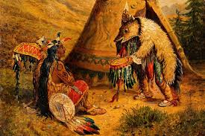
2 Semantic Memory 2.1 Model 2.2 Schemes 2.3 Semantic Networks 2.4 Frames 2.5 Scripts
Schemes makes movements and changes caused by surroundings
Remembering = construction
Canoe -> boat
Paddle -> rowing
„We‘re building up a postural model of ourselves depending on our environment“ (Henry Head)
Smith, Charles (2015): Courtesy of Wellcome Library, no. 45178i.
Baumert, Andreas (2016); Head, Henry (1920)
Notes:
It allows the instruction of interpretation of new information for understanding and finally learning
Experiment with participants who read an american indian tale and after 15 minutes they had to reconstruct it
Step by step an increase of variations to the original
Months later they were asked again and some words changed
Remembering is not a reconstruction of what we know but its a construction
because our surroundings change regulary
and we‘re building up a postural model of ourselves
Its not a reconstruction because we always create new relations

Slide 10
2 Semantic Memory 2.1 Model 2.2 Schemes 2.3 Semantic Networks 2.4 Frames 2.5 Scripts
Declaratively knowledge (facts)
Learned simple multiplication tables by heart
Procedually knowledge (processes)
Addition -> multiplication of big pairs of numbers
Readers need schemes to understand a text
Baumert, Andreas (2016)
Notes:
If we try to learn something new we‘re creating ur learning on existing schemes
When they collerate with memorys that we have for a matter it deforms knowledge that we had
(like indian tale)
Participants deformed it so that it fits better into their scheme or there point of view to the world
A combination of both is a common practise to solve more complex problems

Slide 11
2 Semantic Memory 2.1 Model 2.2 Schemes 2.3 Semantic Networks 2.4 Frames 2.5 Scripts
Build up formal models based on schemes
Including elements and there relations
Need to be compatible in readable code for programming languages
Baumert, Andreas (2016)
Notes:
Testing models of knowledge and language processing in programs
Formal requirement: beeing written in a readable code for programming languages
so that programs can interpet and work with it
Network: Networking of relations of elements in a scheme
Boat -> vehicle
Boat -> canoe, sailboat, motorboat etc.
Boat -> swimming on the water etc. U-boat -> under Water
One of the targets of artificial intelligence is to understand of how human think

Slide 12
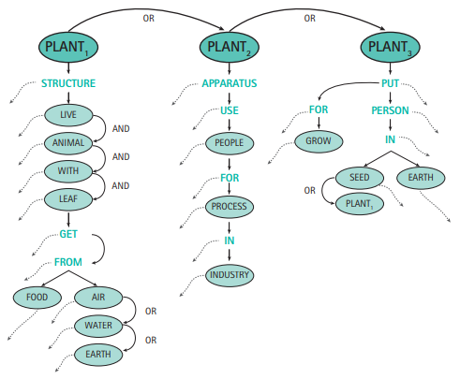
2 Semantic Memory 2.1 Model 2.2 Schemes 2.3 Semantic Networks 2.4 Frames 2.5 Scripts
First semantic network by M. Ross Quillian (1968)
Original by M. Ross Quillian (1968), strongly changed by Baumert, Andreas (2016)
Notes:
For the word „plant“
Shows meanings
Shows relations and affilation to a class or a type
Shows 3 different homonyms
Left: Plant as a lively structure with leaves – that gets nourishment from the air, water or earth
Middle: Plant as an apparatus that people use in the industrie
Right: Plant as a verb that describes how to plant
In simple language they could be used as visualisations of dependencies
Gives an quick overview and is easy readable

Slide 13
2 Semantic Memory 2.1 Model 2.2 Schemes 2.3 Semantic Networks 2.4 Frames 2.5 Scripts
„When one encounters a new situation (or makes a substantial change in one‘s view of a problem), one selects from memory a structure called a frame. (…)“ (Marvin Minsky)
Baumert, Andreas (2016) , Minsky, Marvin Lee (1980):
Notes:
The essence of frames
Like for example visiting a new foreign country
Frames: window that contains the knowledge of an element

Slide 14
2 Semantic Memory 2.1 Model 2.2 Schemes 2.3 Semantic Networks 2.4 Frames 2.5 Scripts
Data-structure
Represents a stereotyped situation
Has attachments of additional information
Baumert, Andreas (2016)
Notes:
Data structure that represents a sterotyped situation like f.e. beeing in a certain kind of living room or going to a birthday party
They could show up the expectations of f.e. clients or a situation
Typical living room of a human in category X
Which car does he prefer?
Which tv show does he like the most?
Which concert would he prefer?
Attachments: how to use a frame, what one can expect to happen next, what to do if these expectations are not confirmed
In programming
In mindmapping
In other classification systems

Slide 15
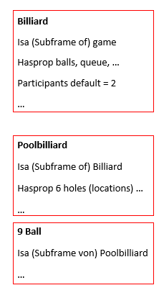
2 Semantic Memory 2.1 Model 2.2 Schemes 2.3 Semantic Networks 2.4 Frames 2.5 Scripts
Frames for Billiard
Baumert, Andreas (2016)
Notes:
- The top levels of a frame are always fixed
represent things that are always true about the supposed situation
- Lover levels of a frame have many terminals
slots must be filled by a specific instances or data
each terminal can specify conditions that its assignments must meet
these assignments are usually smaller sub-frames
- Default-value: 2
* Frames expect that some slots are filled with information, as long as noone else claims something else
* Noone would wonder if someone play billiard alone
Frames and semantic networks can work together: Many objects are similiar
translations are possible without loosing information
both inherit properties / If billiard is played by a queque it implicates that every subframe is played with it too

Slide 16
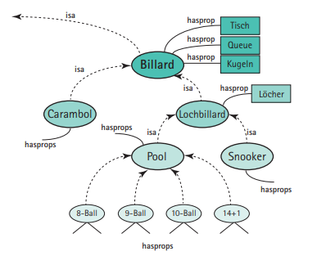
2 Semantic Memory 2.1 Model 2.2 Schemes 2.3 Semantic Networks 2.4 Frames 2.5 Scripts
Baumert, Andreas.(2016)
Notes:
Very similiar to semantic networks
Frames have also nodes and edges
Their differences are often in a terminology and visualisation

Slide 17
2 Semantic Memory 2.1 Model 2.2 Schemes 2.3 Semantic Networks 2.4 Frames 2.5 Scripts
Do you need a queue for 8-Ball?
Baumert, Andreas (2016)
Notes:
Experienced player would directly say yes
And an unexperienced would go through all nodes and edges to find the answer
Reusage of properties could improve the response speed for the answer
When an information occurs frequently in association to a concept it will be saved with the concept, even if its possible to relate it to the superior item
The more often a fact occurs in relation to a concept the more it will associate to the concept. And the stronger facts are associated with a concept the faster it will be verficated with the statement
The differentation of facts, that are not saved into a concept need much time.

Slide 18
2 Semantic Memory 2.1 Model 2.2 Schemes 2.3 Semantic Networks 2.4 Frames 2.5 Scripts
Humans need favorites:
„Twenty or so birds often perch on the telephone wires outside my window and twitter in the morning.“ (Eleanor Rosch)
„A bowl of fruit makes a nice centre-piece“ (Eleanor Rosch)
Baumert, Andreas. (2016), S. 28 – 45, In: Rosch, Human Categorization, S. 25.
Notes:
- Eleanor Rosch figured out by colors that human cognition needs favorites unaffected of culture or speech nor if there even exists a word for a color7
Colors that are easier to recognize and to remember
- Noone would expect that the bird is a pinguine or turkey for example
- In a bowl of fruits noone would expect a watermelon
- The experiments were with students and not with people who have difficulties in understanding
- Schemes and frames are not obious requirements for participants of language
* Sometimes they need to be developed at first to understand a text
Experiments with students and not with people who have difficulties in under

Slide 19
2 Semantic Memory 2.1 Model 2.2 Schemes 2.3 Semantic Networks 2.4 Frames 2.5 Scripts
Contain keywords
Short and concise
Necessary for the understanding of speech
Programs help to verify and optimize scripts
Baumert, Andreas. (2016)
Notes:
Necessary for the understanding of speech and also for the orientation in certain situations

Slide 20
2 Semantic Memory 2.1 Model 2.2 Schemes 2.3 Semantic Networks 2.4 Frames 2.5 Scripts
Waiting for a decission
Hero with a sword
Jabberwocky appears
Spits fire and wants to attack
Final combat
Hero beats Jabberwockys head of
Baumert, Andreas. (2016)
Notes:
We can recognize charakters and protagonists
Useful for organisation storage devices for memories

Slide 21
2 Semantic Memory 2.1 Model 2.2 Schemes 2.3 Semantic Networks 2.4 Frames 2.5 Scripts
Contain a typical sequence of actions
Requirements
Preconditions
Actions
Results
Giving rules
A Base of knowledge helps to receive process
Baumert, Andreas. (2016)
Notes:
So in conclusion
1. You want to reach X
2. Fulfill conditions…
3. Use the following tool
4. Act in this order
5. Prrof if you reached your results
6. What to do if not
7. Otherwise end your work
We need something like a base to create something new

Slide 22
Thank you for your attention!

Slide 23
Sources
Baumert, Andreas. (2016). Leichte Sprache – Einfache Sprache. Abgerufen am 6. Mai 2018, von https://d-nb.info/1097572382/34. S. 28-45.
Universität Bremen. (no date). Phonetik und Phonologie. Abgerufen am 6. Mai 2018, von http://www.fb10.uni-bremen.de/khwagner/phonetik/kapitel1.aspx
Ryte GmbH. (no date). Flesch-Reading-Ease. Abgerufen am 6. Mai 2018, von https://de.ryte.com/wiki/Flesch-Reading-Ease.
Caroll, Lewis (1871). Jabberwocky. Abgerufen am 6. Mai 2018, von https://www.poetryfoundation.org/poems/42916/jabberwocky
Head, Henry (1920): Studies in Neurology. 2 Bände. London: Oxford University Press (2).https://archive.org/details/studiesinneurolo02headiala

Slide 24
Sources
Quillian, M. Ross (1980): Semantic Memory. In: Marvin Lee Minsky (Hg.): Semantic information processing. 3. Aufl. London: The MIT Press, S. 227–270.
Rosch, Eleanor (1977): Human Categorization. In: Neil Warren (Hg.): Advances in Cross-Cultural Psychology, Bd. 1. London: Academic Press, S. 1–48.
Minsky, Marvin Lee (1980): A Framework for Representing Knowledge. In: Dieter Metzing (Hg.): Frame conceptions and text understanding. Berlin: de Gruyter (Research in text theory, 5), S. 1–25.
Smith, Charles (2015): Courtesy of Wellcome Library, no. 45178i. http://www.thedifferentialdx.com/native-american-history-a-tale-of-medicine/

