Slide 1
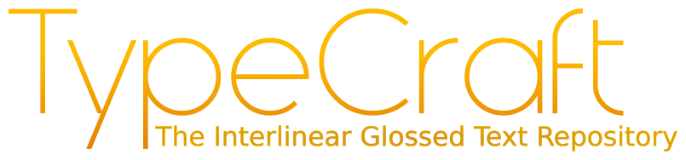
Verb valency and its relevance for simple language
Suna Kaya, 07.05.2018

Slide 2
AGENDA
1. TypeCraft
1.1 Editor
1.2 Editor Basics
1.3 Database
2. Verb valency in German
3. Inflectional morphology
4. Relevance

Slide 3
TypeCraft
Free online application
Interlinear Glossing Editor (IGT)
Natural language database
Creation, storage and retrieval of user data
Notes:
TypeCraft is a free online application consisting of a natural language database and a interlinear glossing editor.
Written material is stored in a relational database from where it can be retrieved.
The system is specialised on manual morphe-to-morphe annotation of natural language texts. Therefore users can import raw data and add lingustic annotations to the written materials. Summed up the activities supported by the system are creation, storage and retrieval of user data.
TypeCraft data is structered throughout, which makes it possible to search on all levels (text, phrase, word and morphe).
The system allows for incomplete annotations, and the storage of extensive comments together with the data.
Annotations and Texts are in Unicode, so it can be exported to standard text editors (e.g. Word or LaTex), as well as to XML format.

Slide 4
TypeCraft – Editor
Log-in to edit
Search open to genereal public
Unicode
Notes:
If users want to use the TypeCraft wiki for research purposes, they can use it without log-in. But if they want to edit the Wiki or use the TypeCraft Editor, they need to be logged in.

Slide 5
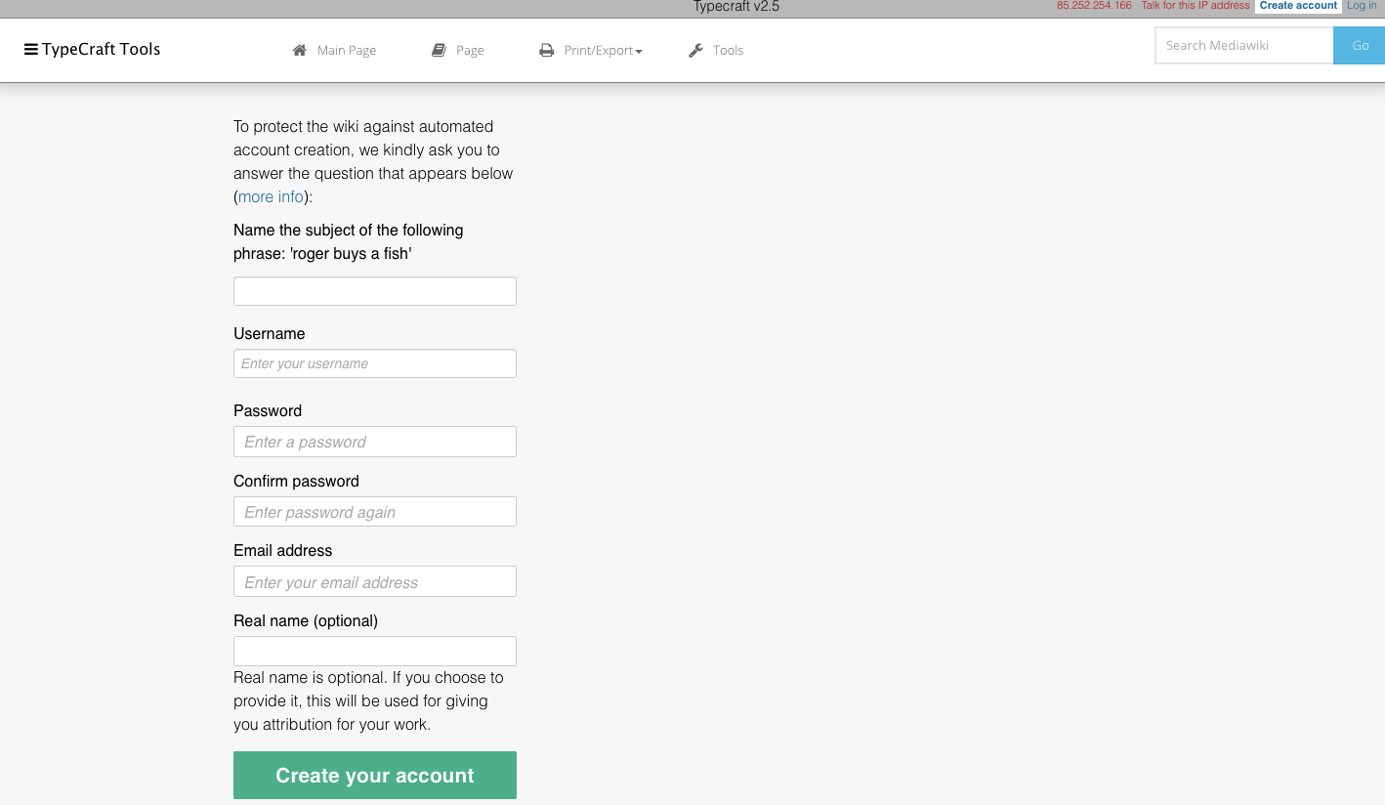
TypeCraft Editor – Basics
Notes:
The displayed Figure shows the form to create an account. After entering some Information and confirming an email the user can log in use the tool for free.

Slide 6
TypeCraft – Database
Portal of languages
2605 Texts
Over 150 unique languages
Download function
Notes:
The Database or the portal of languages consists of over 150 languages, which together have over 2600 texts. It also have the function to download written material.

Slide 7
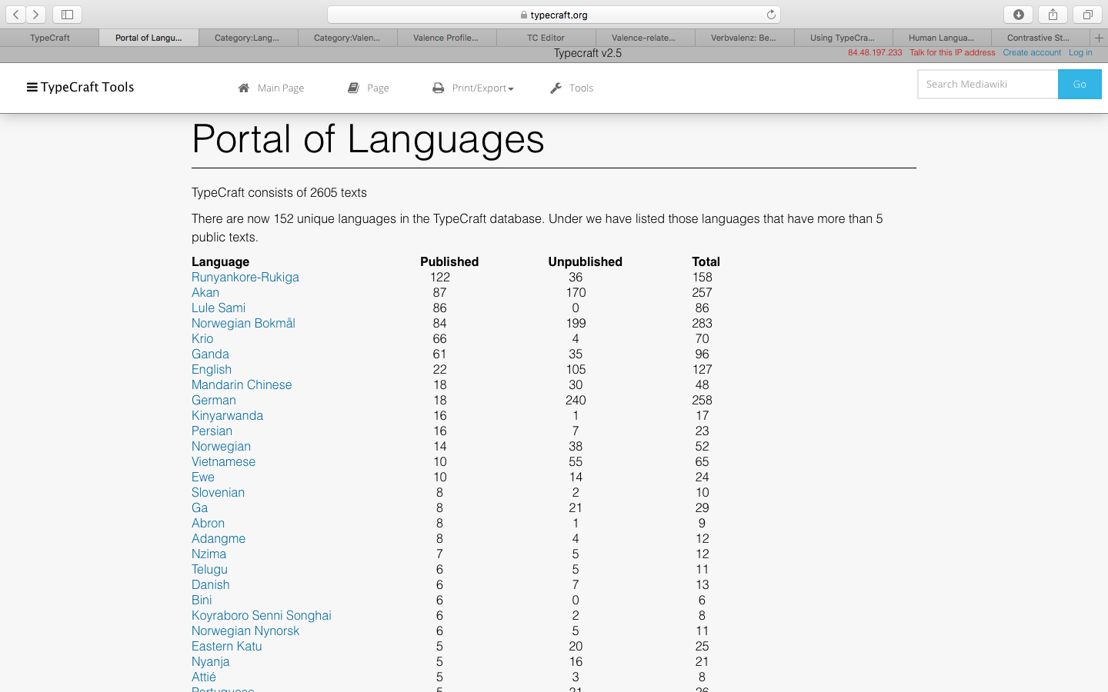
TypeCraft – Database
Notes:
Overview page of the Portal of languages.

Slide 8
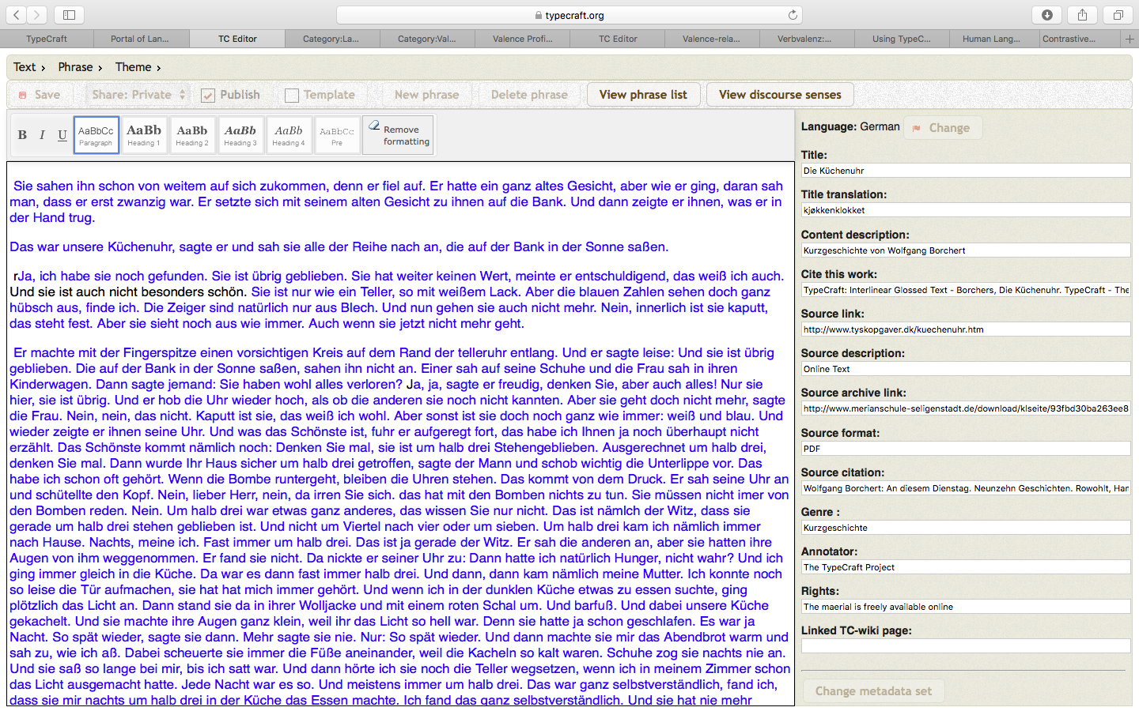
TypeCraft – Database
Notes:
Example of a text, in this case in german. On the right side: added information in relation to the text.

Slide 9
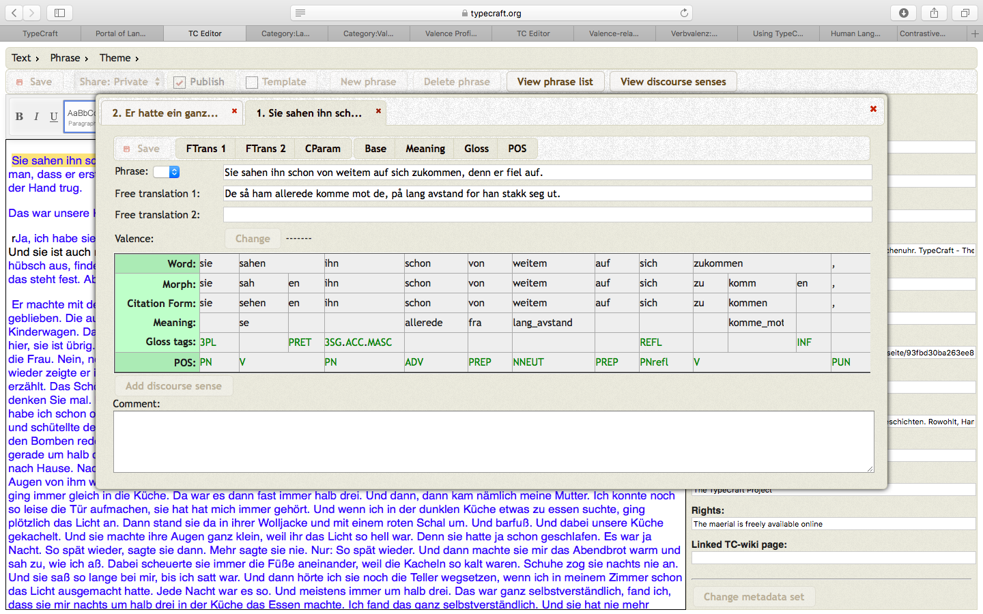
TypeCraft – Database
Notes:
If you click on a sentence in the text, a new window with more information opens. The information belongs to the clicked sentence and shows its morphe-to-morphe annotations.

Slide 10
Verb valency in German
Verbs = „doing“ word
In the centre of a sentence
Valency = capacity to take an argument
Intransitiv, transitiv, ditransitiv
Notes:
A Verb is a word used to describe an action, state, or occurrence, and forming the main part of the predicate of a sentence, such as hear, become, happen.
The verb stands in the centre of a sentence and has the posibility to call for supplements
Valency describes the potential of a verb to demand the maximum number of nouns that can be in a clause. The nouns are called “arguments”.

Slide 11
Verb valency in German
Intransitiv / monovalent
“schlafen“ (sleep) → Ich schlafe. (I sleep)
„tanzen“ (dance) → Wir tanzen auf der Party. (We dance at the party)
Notes:
Intransitiv means, that the verb needs the minimum number of one argument, to build a correct sentence.
In the second intransitiv example the part „auf der Party/ at the party) is additional, but not a need.

Slide 12
Verb valency in German
Transitiv / divalent
„suchen“ (search) → „Peter sucht sein Telefon“ (Peter searches his mobile phone)
„lieben“ (love) → „Ich liebe dich“ (I love you)
Notes:
The verb „suchen“ (search) needs two additions in German to become a correct sentence. So it is an example for transitiv verbs

Slide 13
Verb valency in German
Ditransitiv / trivalent
„schenken“ (to give) → „Ich schenke dir eine Uhr“ (I‘ll give you a watch)
„geben“ (to give)→ „Der Mann gibt dem Kind das Buch“(The man gives the book to the child)
He gives X to Y.
Notes:
Ditransitiv verbs need three arguments to build a correct sentence.

Slide 14
Morphology
Origin: Medicine, Biology
In lingustic: study of words of how they are formed and their relationship to other words
„Waldweg“ – „Wald-weg“ → lexical structure
“Wegen des Waldweges“, „die schönen Waldwege“ → appareance in relation with other words

Slide 15
Inflection (Flexion)
Paradigm of words
Verbs: Person
Numerus
Modus
Tempus
Genus Verbi
“Der Vater ruft den Sohn“ oder „Den Sohn ruft der Vater“
„ The father calls the son“ ≠ „The son calls the father“
→ „The son is called by the father“

Slide 16
Inflectional morphology
Analytic form
low morpheme-per-word
Conveys relationship between words
Breaks up concepts into seperate words
Synthetic form
high morpheme-per-word
Composes multiple concepts into each word
Notes:
Why verb valency is important and relevant in german language and why it is relevant for simple language. To understand this easier, you have to know the concept of analytic and synthetic language, because the german language makes use of auxiliry verbs.
The lexical and gramatical point of view are distributed into seperate arguments in Analytic language.
Analytic language is a language that primarily conveys relationships between words in sentences by way of helper words. It usually has a low morpheme-per-word.
A synthetic language is a language with a high morpheme-per-word ratio.
Synthetic languages compose multiple concepts into each word, while analytic languages break up (analyze) concepts into separate words.

Slide 17
Inflectional morphology
„Ich habe gegessen“ (I did eat)
„ist gegangen“ (did go)
„wird gehen“ (will go)
Auxiliary verb „habe“, „ist“ „wird“ → grammatical information
“Ich aß“
Synthetic (I ate)
→ no use of an auxiliry verb
Notes:
The helping verb „habe“ (have) says something about the grammatical information and is easier to understand than the more syntetic way of saying the same thing, because both sentences „Ich habe gegessen“ and „Ich aß“ make the same statement.

Slide 18
Relevance – Analytic Form
Positiv: transparent seperation of each function
Negativ: connected words stand seperatly
“Das Flugzeug ist gestern Nachmittag in Boston gelandet.“
Notes:
The question if the analytic or the syntetic form is easier to use for simple language is relativ hard to answer because:
The positve aspect of analytic forms is that they have a transparent seperation of each function, but the issue is, that connected words or categories don‘t stand in the same position or order.

Slide 19
Relevance – Synthetic Form
Positiv: relevant information captured independent of the construction
Negativ: intransparent fusion is harder to understand
Notes:
The intransparent fusion of the grammatical and lexical point of view of words in synthetic form can be harder to understand the context of a sentence.
But all relevant informations can be captured simultaneously independent of the construction.

Slide 20
Relevance
Analytical forms > synthetic forms in German
Auxiliry verbs prefered
Function of each word defined clearly
Notes:
So which form fits better to simple language?
If we have a choice than we will use the analytic form, because here the positiv aspect of the fact that the functions of each word are defined clearly overweights.
To make the language simple it is prefered to use helping verbs in order to help people understand the statement better.

Slide 21
THANK YOU FOR YOUR ATTENTION!

Slide 22
Sources:
Breidel, U., Maaß C.: Leichte Sprache: Theoretische Grundlagen ?Orientierung für die Praxis, Augsburg, 2016.
Maaß, C.: Morphologie, Hildesheim, 2014.
Vetulani Z., Mariani J., Human Language Technology Challenges for Computer Science and Linguistics, Poznan, 2014,
https://www.germanistik.uni-kiel.de/de/lehrbereiche/niederdeutsch/studium/downloads/Einf%20Sprwiss%2010%20-%20Syntax%20I.pdf
http://www.canoo.net/services/OnlineGrammar/Wort/Verb/Valenz/Trans-Intrans.html, online abgerufen am 27.04.2018
http://mein-deutschbuch.de/nominalisierung.html, online abgerufen am 28.04.2018

