Slide 1
Leichte Sprache and Language Technology
Melanie Siegel

Slide 2
Leichte Sprache: Goals
main target group for LS: people with intellectual disabilities
stated that it might be helpful for other target groups as well
checking groups, consisting of persons from the target group
Notes:
LS was initiated by associations supporting people with intellectual disabilities
they state that it could be helpful for other target groups, such as people who are learning German (personal experience)

Slide 3
Various German websites offer information in LS

Slide 4
Various German websites offer information in LS
https://www.bundestag.de/leichte_sprache/
https://www.gruene-bundestag.de/behindertenpolitik/behindertenpolitik-in-leichter-sprache-10-10-2009/bilder-in-texten-mit-leichter-sprache-24-06-2014.html

Slide 5
Various German websites offer information in LS
https://www.lebenshilfe.de/de/leichte-sprache/freizeit/Downloads/Fussball-Regeln-in-LS.pdf
https://www.stadtgrenze.de/leicht/stadtplanung.html

Slide 6
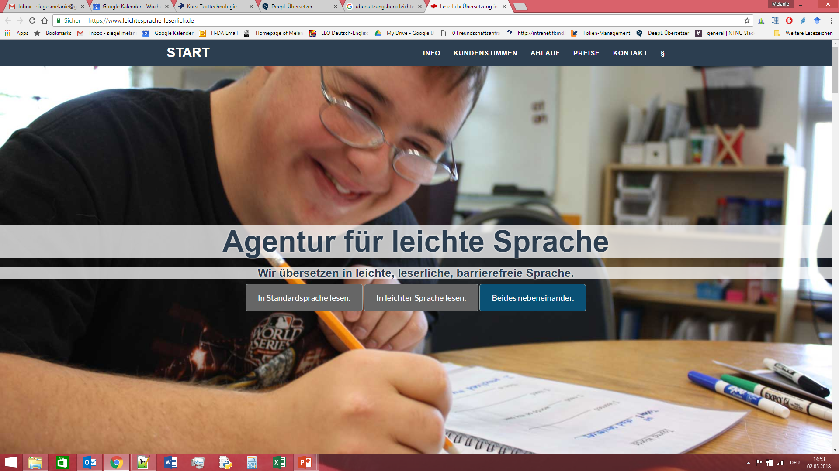
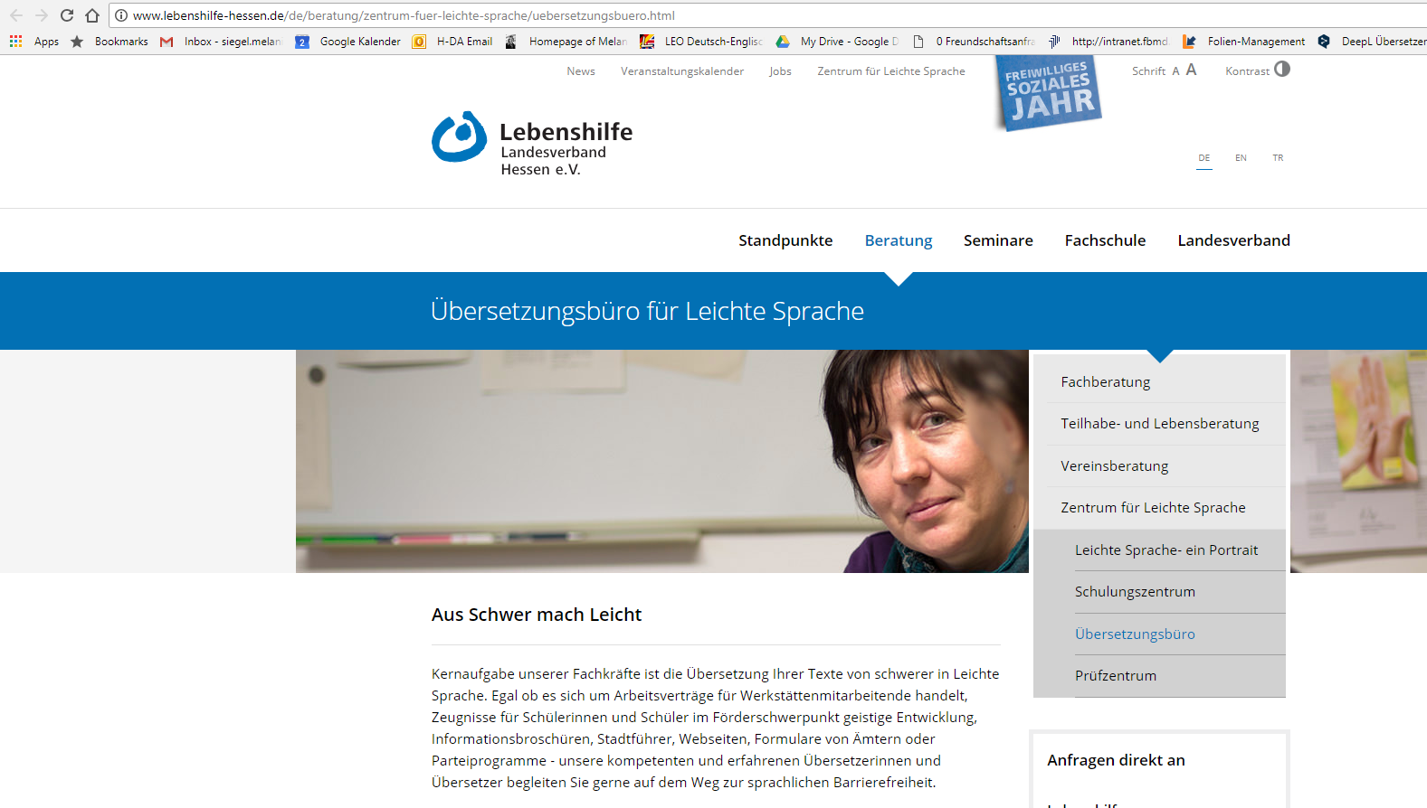
Translators offer translations to LS
Notes:
just some examples

Slide 7
Tools that these translators use
Hurraki:
dictionary of words and their explanations
e.g.
Arzt: Ein Arzt ist jemand, der Medizin studiert hat. Zum Arzt geht man, wenn man krank ist.
wiki, written by the community
https://hurraki.de/
Lists of rules
e.g., https://www.leichte-sprache.org/wp-content/uploads/2017/11/Regeln_Leichte_Sprache.pdf

Slide 8
Tools that these translators do not use
terminology databases
authoring support software
translation memories
machine translation
Notes:
authoring support software: acrolinx, languagetool, textlab

Slide 9
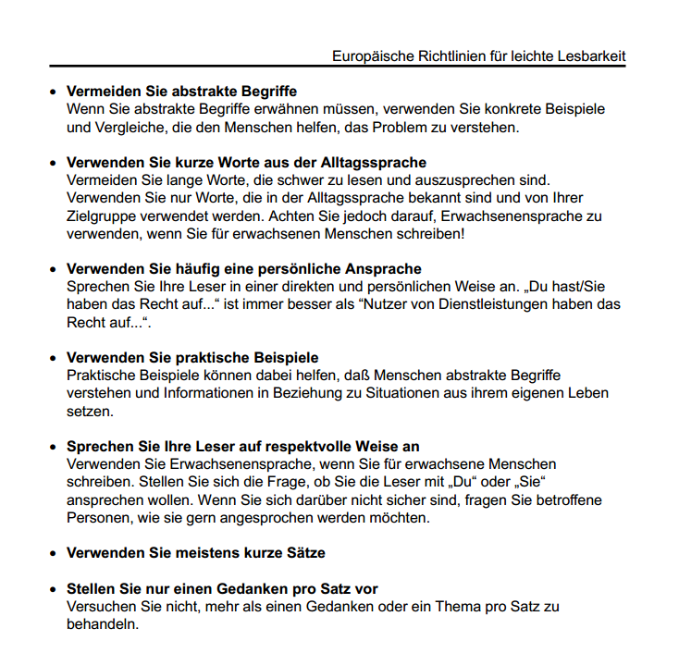
http://www.webforall.info/wp-content/uploads/2012/12/EURichtlinie_sag_es_einfach.pdf
Notes:
Europäische Richtlinien für leichte Lesbarkeit:
Instructions for authors
20 linguistic rules, here only an excerpt
no examples
Rules in "normal" language

Slide 10
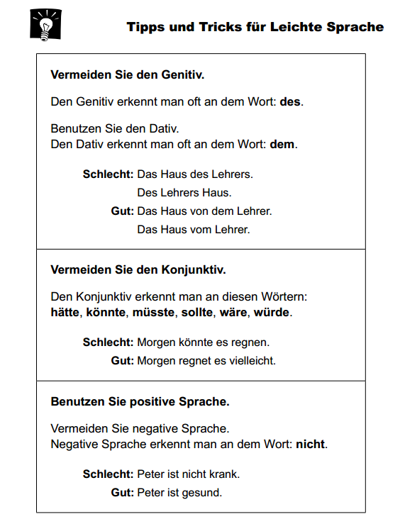
Netzwerk Leichte Sprache (Aktion Mensch)
http://www.leichtesprache.org/downloads/Regeln_Netzwerk_Leichte_Sprache.pdf
Notes:
Netzwerk Leichte Sprache (Aktion Mensch)
43 rules
Positive and negative examples for the rules
Rules are written in an easy language

Slide 11
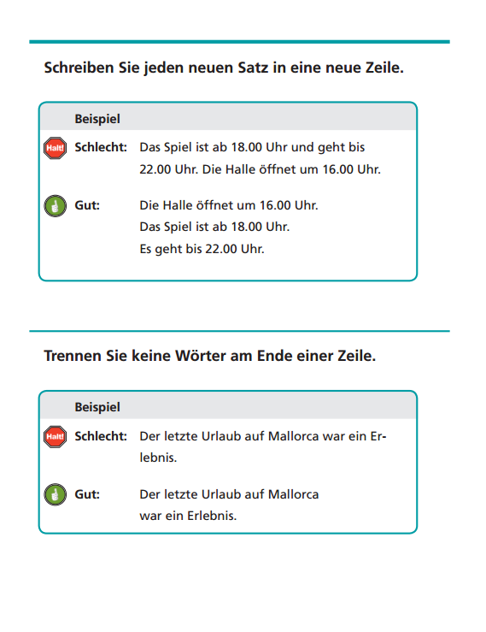
Netzwerk Leichte Sprache (Lebenshilfe Bremen)
http://www.leichte-sprache.de/dokumente/upload/22751_regeln_fuer_leichte_sprache.pdf
Notes:
Netzwerk Leichte Sprache (Lebenshilfe Bremen)
Positive and negative examples for the rules
approx. 40 rules
Rules are written in LS

Slide 12
Problems
rules are not written by linguists
rules are not precise (how long is a sentence that is too long?)
rules are not based on empirical research
rules are written for one target group, and it is just stated that they are useful for other target groups

Slide 13
Research on LS: Hildesheim
Forschungsstelle Leichte Sprache
scientific basis for LS rules
medio point instead of dash:
Fach·text
Fach-Text
https://www.uni-hildesheim.de/leichtesprache/

Slide 14
Research on LS: Leipzig
LeiSA-Studie:
LS in the world of work
http://research.uni-leipzig.de/leisa/de/
social science sub-project
linguistic sub-project

Slide 15
Research on LS: Hochschule Darmstadt / SAP
Siegel, Melanie und Christian Lieske(2015): Beitrag der Sprachtechnologie zur Barrierefreiheit: Unterstützung für Leichte Sprache. In: trans-kom 8 [1] (2015): 40-78.
comparing rule sets for LS
implementing rules in authoring tools (Acrolinx, LanguageTool)
refining rule sets for LS, on the basis of:
implementation of existing rule sets
rules for technical documentation
rules for pre-editing in machine translation

Slide 16
Language technology for LS
Advantages for LS
tools to support the authoring process
formalization and therefore more precise definition of the rules for LS
Advantages for language technology
another application area
insights into the complexity of language
methods to automatically reduce language complexity

Slide 17
Language technology for LS (ideas)
terminology database with complicated words and their LS variants
supporting the authoring process by proposing LS variants
data for this database automatically extracted from text corpora
LS definitions for words connected to text
automatic hyperlinking
LanguageTool for the authoring process
translation memory, setup from parallel texts
machine translation

Slide 18
Summary
need for the LS was made clear by associations for the disabled
first rules were set up by these associations
translation offices for LS emerged
sociological and linguistic research on LS
word lists and definitions (Hurraki)
first attempts for authoring support tools came from technical documentation

Slide 19
Next steps
corpus of LS texts and texts in standard German (on the same topic)
domains?
Leichte Sprache, Klare Sprache, Einfache Sprache?
dictionary of LS and SG words
extract from corpus
find synonyms / connect in OdeNet

