Slide 1
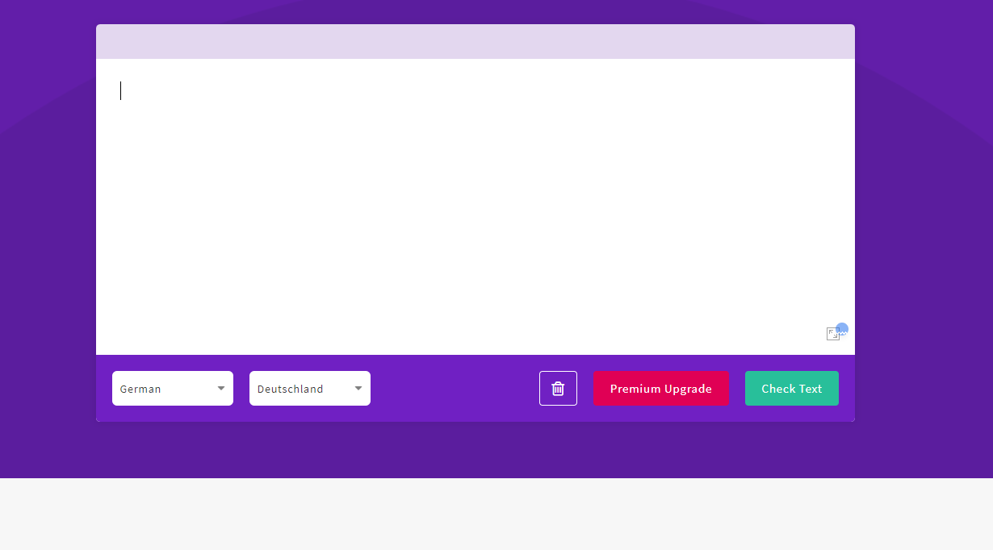
Introduction to the LanguageTool
Focus on rules for Simple German

Slide 2
01
Description of the LanguageTool
Spell, grammar and style checker
Detects errors an highlights them
Notes:
General Information:
free and open-source spell, grammar and style checker
Detected errors will be highlighted -> scratch for further explanations
No changes by itself -> only highlights and gives hint

Slide 3
01
Description of the LanguageTool
Spell, grammar and style checker
Detects errors an highlights them
Further explanations can be shown
First Version in 2005 - still under development
25 languages are supported, as well as some dialects
Notes:
based on different rules concerning spell, grammer and style errors
For non-native speakers, also native speakers (typical mistakes that native speakers commonly make)
25 languages are supported & further dialects
https://chrome.google.com/webstore/detail/languagetool-grammar-and/oldceeleldhonbafppcapldpdifcinji?hl=en-GB

Slide 4
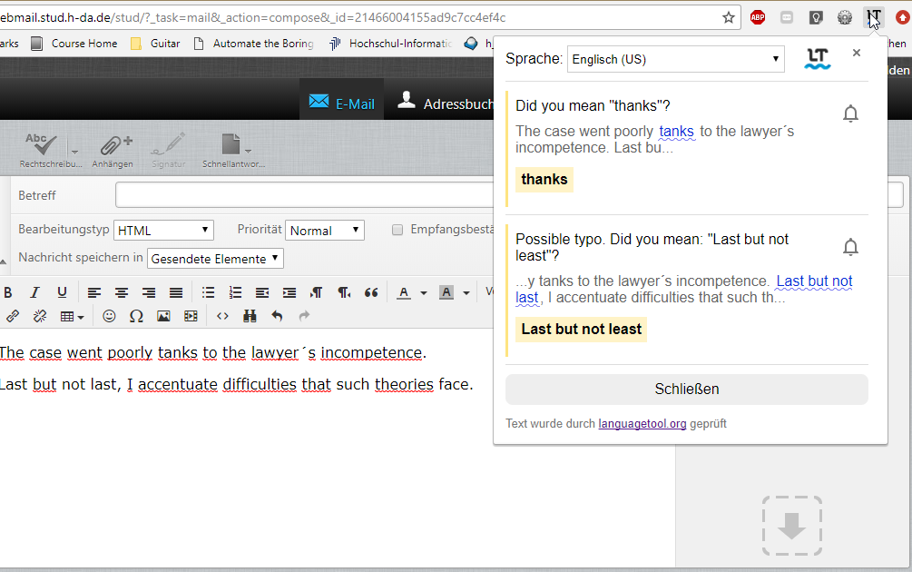
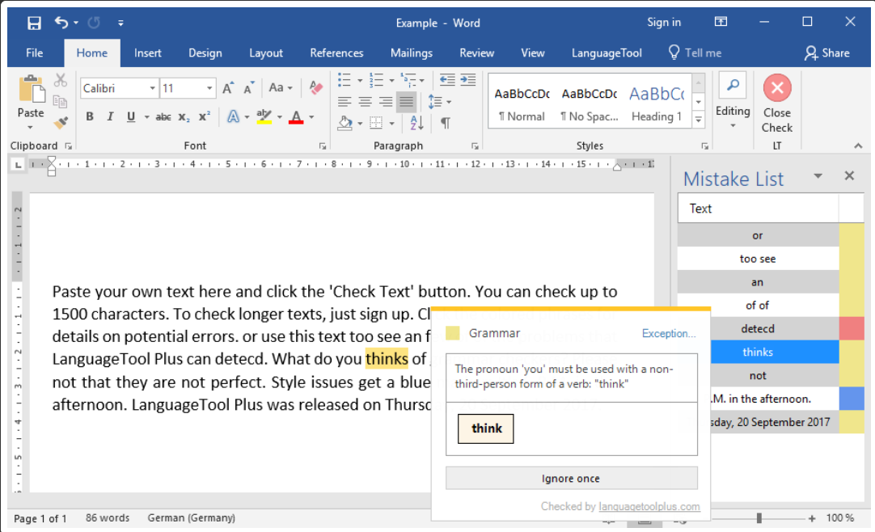
01
Application of the LanguageTool
Notes:
integrated as a Browser Extension (writing an Email, an article in a forum or a comment)
Errors in pop-up
Text Editors as Microsoft office or Latex.

Slide 5
02
How does the LanguageTool work?
Notes:
takes a text and matches it against certain predefined rules
Tokens, sentences and parts of sentences match?

Slide 6
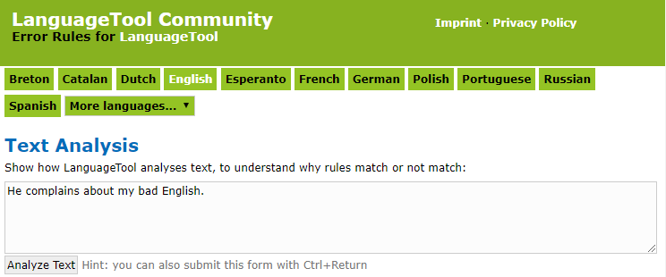
02
Text Analysis
https://community.languagetool.org/analysis/index?lang=en
Notes:
text is split into sentences, into parts and token

Slide 7
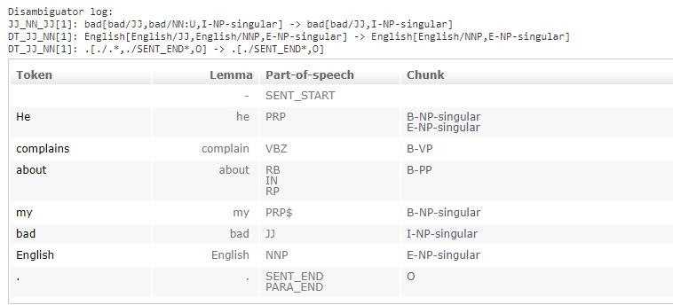
02
Text Analysis
Notes:
Split into sentences
Define tokens & Lemma Version
Tokens with multiple grammatical forms

Slide 8
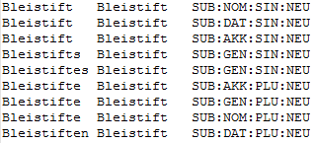
02
Text Analysis
Tags
Noun (singular, plural),
Verb (past tense, present tense…)
Determiner
Adjective
Adverb
…
Important: Especially for words that can be used in different forms
I will (will be) and the will (wish/intention)
Token Lemma POS
Notes:
Part-of-speech tagging: tag nouns, verbs, adjectives or adverbs. (integrated by dictionaries.)
But: some token might have multiple pos tags depending on the token and the context.: “The sailor dogs the hatch.”
Definition of the word
- integrate the context of the word by rules. For example: A rule would say something like: ”if a token has tag A but it is followed by tag X, then make it tag B”.
Disambiguator: differenciation of tokens
POS
Most taggers in LanguageTool are dictionary-based

Slide 9
02
Text Analysis
Notes:
Split into sentences
Define tokens & Lemma Version
Tokens with multiple grammatical forms

Slide 10
02
Text Analysis
Notes:
Split into sentences
Define tokens & Lemma Version
Tokens with multiple grammatical forms

Slide 11
02
Text Analysis
“He complains about my bed English“
NP
VP
PP
NP
He
complains
about
my
bad
English
sb
nn
vb
pp
pr
adj
B – Beginning of a Chunk
I – Continuation of a Chunk
E – End of a Chunk
NP – Noun Chunk
VP – Verb Chunk
Notes:
Text chunking: dividing a text in syntactically correlated parts of words, (noun groups, verb groups)
single content word, + function words. Like “my bed accent”.
Defined by Regular Expressions or build with rules that create POS tag sequences.
→ Based on statistical algorithms

Slide 12
02
Text Analysis
Notes:
Split into sentences
Define tokens & Lemma Version
Tokens with multiple grammatical forms

Slide 13
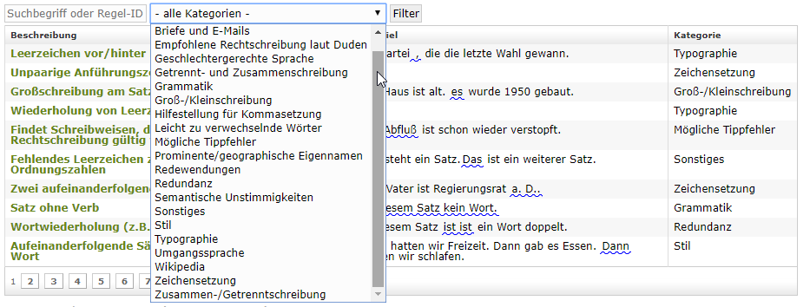
03
Predefined Rules
“write documents with fewer errors and with better style.”
Notes:
Development purpose: documents with fewer errors and with better style.
help a students as well as professional
rules already: Capitalization, Punctuation or Possible Typos.
- can be adjusted as required for individual use

Slide 14
04
Example of a Rule in XML

Slide 15
05
XML Rules Simple German
Word Level
Sentence Level
Text Level
Abbreviation
Numbers
Difficult Words
Long Words
Long sentences
Passive sentences
Indirect speech
Negation
Metaphor
Subjunctive/ Konjunktiv
Genitive
Präteritum/ Perfect
Special Character
References
Numbers
Difficult Words
Long Words
Notes:
- especially rules related to Verbvalences.

Slide 16
05
XML Rules Simple German
Word Level
Word Level
Abbreviation
Numbers
Difficult Words
Long Words
Notes:
Rules for Simple German
simple, short, and well-known
whole list of complex words and their simplifications.

Slide 17
05
XML Rules Simple German
Sentence Level
Long sentences
Passive sentences
Indirect speech
Negation
Metaphor
Subjunctive/Konjunktiv
Genitive
Präteritum/ Perfect
Numbers
Difficult Words
Long Words
Notes:
- especially rules related to Verbvalences.

Slide 18
05
Passive Sentence
„Der Manager wurde gefeuert“ → „ Jemand feuerte den Manager“
„The Manager was fired“ → „ Somebody fired the manager“
Notes:
Passiv: harder to understand
Subject receives an action, instead of acting upon an object
Subject is not defined-
require a specific Subject in a sentence.

Slide 19
05
Passive Sentence
„Der Manager wurde gefeuert“
Notes:
detect: “werden” in all its forms + Verb
participle 2 – like gefeuert..

Slide 20
05
Subjunctive / Konjunktiv
„Morgen könnte es regnen“ → „Morgen regnet es vielleicht.“
„It might rain tomorrow“ → „Maybe it is raining tomorrow.“
Notes:
the Konjunktiv 1 and 2.
used to create hypothetical situations, express wishes or doubt over an idea, it enables speculations or just to express unreal conditions.
sentence has to be split up in

Slide 21
05
Subjunctive / Konjunktiv
„Morgen könnte es regnen“
Notes:
modal and auxiliar words in Konjunktiv, like hätte, könnte, müsste, sollte, wäre, würde.

Slide 22
05
Indirect speech
„Er sagte, er sei 30 Jahre alt.“ → Er sagte: „Ich bin 30 Jahre alt.“
„He said, he was 30 years old“ → „ He said: „I am 30 years old“
Notes:
The Konjunktiv 1 is most likely used in indirect Speech

Slide 23
05
Indirect speech
Notes:
Words like: say, answer, respond and so on. + Verb

Slide 24
05
Präteritum / Perfect
„Ich ging einkaufen“ → „Ich bin einkaufen gegangen.“
„I went shopping.“ → „I had gone shopping“
Notes:
no big difference for using those two forms and in colloquial language the Perfect is mostly used and therefore easier to understand.

Slide 25
05
Präteritum / Perfect
Exception: haben, sein, können, sollen, wollen, müssen, dürfen
Notes:
The Verb-form of the Präteritum can be found by indicating verbs Therefore, all Verbs in form of Präteritum are selected. But as verbs like haben or sein or other Modal/Auxiliar Verbs are easier to understand in Präteritum. This form is used in texts very often and can be recognized a lot easier as their perfect form. Therefore, they are further used in Präteritum form.

Slide 26
05
XML Rules Simple German
Text Level
Special characters ()[]{} < > << >>
References

Slide 27
06
How can we profit from the LanguageTool?

Slide 28
06
How can this tool be helpful for the projekt?
Advantages
Big database for words and tags
Big database for rules
Free and open sourced
Can be adjusted to fit personal needs

Slide 29
06
Boundaries of the LanguageTool
Boundaries
Only highlights errors
Gives information about the error
→ but has not enough information to be able to correct each specific error
All errors have to be defined to be detected

Slide 30
07
Summary
Great possibility to check text for spell, grammar and style errors
Great database on different rules for Simple German
Possibility to indicate new rules in XML
Not complete or final (still rules missing)
No automatic translation

Slide 31
08
Sources
Naber, Daniel; Milkowski, Marcin (2005). Version 4.1. Online verfügbar unter https://languagetool.org/.
Maaß, Christiane: Leichte Sprache. Das Regelbuch (Barrierefreie Kommunikation, 1).

Slide 32
05
Disambiguator

Slide 33
04
Text Analyzation
Notes:
Split into sentences
Define tokens & Lemma Version
Tokens with multiple grammatical forms

Slide 34
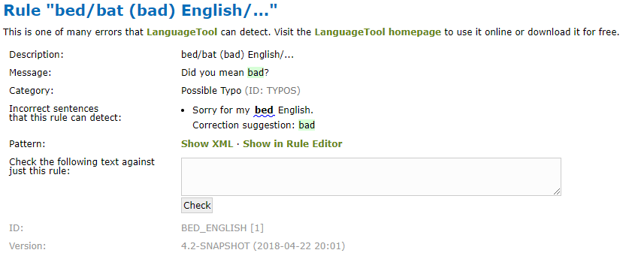
06
XML Rules

Slide 35
06
Subjunctive / Konjunktiv

Slide 36
06
XML Rules Simplification
regular expressions: “half an hour”. For Regex the system searches for regular expressions per sentence.
inflection attribute: match not only the given word, but also all of its inflected forms.
<token inflected="yes">bicycle</token>
will match bicycle, bicycles, bicycling etc.
Noch eine Regel?

Slide 37
06
Further Rules for Simple German
On Sentence Level
Sentences with more than one information or several constituents (seperated via semicolon or several verbs)
Constructions with an Infinitiv
Constructions with subordinate clauses
Notes:
Filler: Füllwörter, Wörter, die zum Verständnis nicht notwendig sind, wie zum Beispiel, ja, gar und also

