Slide 1
Klarspråk
DAAD-NFR Prosjekt: Aspects of Linguistic Complexity. An introduction to the e-learning course in klaspråk
Anna Struck

Slide 2
Content
What is Klarspråk?
Video
The communication gap
The Klarspråk movement
How is this realised?
The e-learning course
Sections 1-5
For leaders
The linguistic aspect
Examples
Communicative/Linguistic
The cooperative principle

Slide 3
Notes:
So basically what happened is this: David comes to ask his neighbour Frida, whether her water supply has been cut off as well. Frida answers that they are currently doing some maintenance on the water network and that they received a notice about this- to which David replies: Ah, is that what the cryptic message was about yesterday?
In translation, what the message they got said was this: Because of maintenance work on the distribution system, there will be some disturbances on part of the network in Vinkelveien 1-15 on Tuesday 8. of July. It is recommended to provide by filling some bottles beforehand.

Slide 4
The communication gap
What happened? Frida understood the text and prepared by filling water into bottles, while David misunderstood completely and was left unprepared.
There seems to be a gap in communication between governmental institutions and the Davids in the world.
“Klarspråk” is a movement that developed over the past years in order to work on closing this gap.

Slide 5
The «Klarspråk» movement
“Klarspråk” focuses on the information itself, how it is conveyed and how it can reach the receiver in such a way, that he has a proper use for it. The main point is to make it possible for the person at the other end to get the information they need, to understand it and to use it for what it was intended to.
There are three main reasons to work with “Klarspråk”:
It promotes democracy and understanding of the legal system: Often people do not understand from complicated and complex texts, what their actual rights and duties are.
It creates trust: When a text is hardly understandable the reader could get the impression that the sender has something to hide.
It increases effectivity: Simplicity and understandability save time and money, while the need for explanations and repetitions consume it.

Slide 6
How is this realised?
Several Norwegian institutions like ”Mattilsynet, Lotteritilsynet and Trondheim Kommune” already offer “Klarspråk” on their websites, and work actively to realise its goals.
Governmental institutions together with the Språkrådet have created public services to explore ”Klarspråk” . They offer examples for official texts that have been re-formulated in “Klarspråk”.
http://www.sprakradet.no/Klarsprak/kommunesektoren/

Slide 7
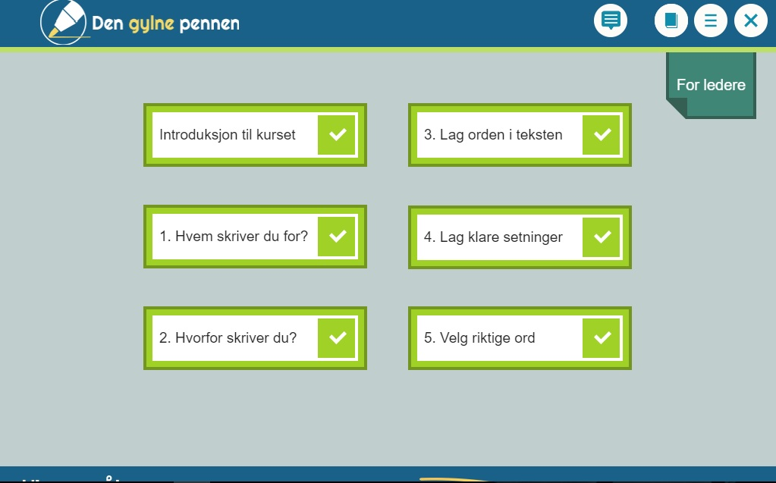
The e-learning course
“The golden pen”
A course to learn how to use or improve your skills in “Klarspråk”.
The course is divided into 5 parts where each section focuses on a different topic.
Each section ends with a summary and some questions, where the taker has the opportunity to test their gained knowledge, before moving on to the next part.

Slide 9
Section 1: The recipient
- Consider the history and occupational background of the recipient
- Give precise information concerning their specific situation
- The recipient has to be able to draw the correct information from the text and be able to use it for what he intended to.
- In the case of several recipients the “weakest link” is to be taken as a measuring pole.

Slide 10
Section 2: Relevance
- Explain difficult terminology
- Make it clear which rules concern whom
- Avoid the bureaucratic language (more on this later…)
- Try to avoid unnecessary information,
which makes it difficult to differentiate which rules apply for which person or situation.

Slide 11
Section 3: Clarity
- Headliners should create clarity from the beginning
- Be informative, specific and non-cryptic
- The text should get to the point
- Order text properly with headliners and paragraphs

Slide 12
Section 4: Structure
- Avoid unnecessary information
- Avoid long and complicated sentences
- Avoid sentences that are compromised, aim for the proper amount of information
- Use verbs instead of big nouns to make the point less abstract
- Avoid passive constructions, get across who is supposed to do what

Slide 13
Section 5: Word choice
- Save the words, avoid fillers and unnecessary clarifications
- Choose simple words
- Avoid outdated, over-used and juvenile expressions
- Explain terminology the first time you use it
- Refrain from explaining terminology with further terminology

Slide 14
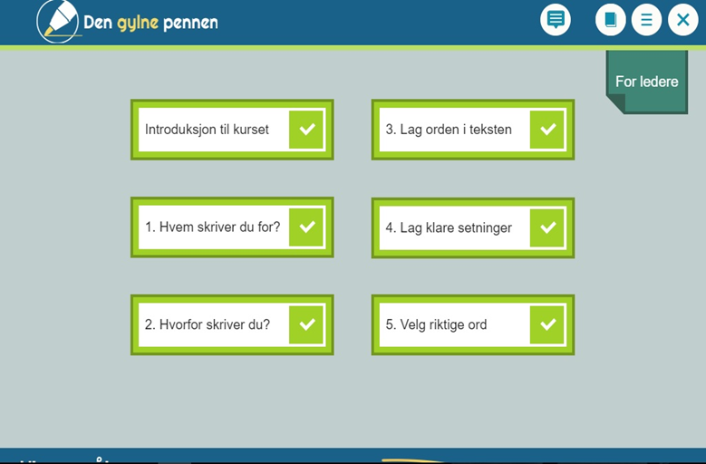
For leaders
After you have gone through the main part of the course, there is the possibility to choose a section entitled “for leaders”.
This will give you a short overview of how you as a leader of a group, be it work or otherwise, can encourage and execute “Klarspråk”.

Slide 15
How to work with it?
A few questions to ask about the current situation:
Is there a fellow understanding at the workplace for why this should be executed?
Is there a fellow understanding of the terminology used?
What is the background of the workers and how is the feedback?
Are the texts the responsibility of a single person or a group?
Is there a collaboration creating these texts and how is the communication between these parts?
Why encourage it?
It promotes…
…quality
…trust
…tool to achieve better results
The work with “Klarspråk” is a work of change and progress. It serves to improve routines and connections in the long run.

Slide 17
The linguistic aspect
The material shown so far gives a better overall understanding of the concept of «Klarspråk» - however, we are not trying to learn how to write proper Norwegian, but we are interested in the linguistic aspect of it. So setting aside the parts dealing with basic grammar rules this concerns things like:
Compound words
Passive constructions
Nominalizations
Outdated verbs and nouns
Invented names
Constituents used like fillers

Slide 18
Examples
“Bezirksschornsteinfegermeister” - Districtchimneysweepmaster
“Ved avbruddets opphør…”/ “”Mit der Vollendung des…”
“Compliance” – “comply”

Slide 19
More examples
1. „Etter en totalvurdering av fareelementet foreligger det en erkjennelse av at arten krokodille representerer en betydelig risikofaktor for personen.“
2. „Nach einer Gesamtbewertung des Gefahrenelementes liegt eine Erkenntnis vor, dass die Tierart Krokodil einen beträchtlichen Risikofaktor für die Einzelperson darstellt.“
The simpler version:
1. „Pass deg for krokodillene. De kan angripe!“
2. „Hüten Sie sich vor Krokodilen. Sie könnten angreifen!“

Slide 20
Two dimensions of the concept „Klarspråk“:
Communicative
Linguistic
Often the communication between governmental institutions and people is unempathetic and unnecessarily aggressive.
An acknowledgement of the situation on both sides would help to get a better understanding and in order for this to happen, both parts first have to establish a common ground where the facts are clear.
Both dimensions are important to consider when working with Klarspråk.
How could the communicative side be taken into consideration?

Slide 21
The cooperative principle
Maybe possible to adjust Grice‘s maxims for this particular situation?
The maxim of quantity - be as informative as possible and give as much information as is needed, and no more.
The maxim of quality - be truthful and don’t give information that is false or that is not supported by evidence.
The maxim of relation - be relevant and say things that are pertinent to the discussion.
The maxim of manner - be as clear, as brief and as orderly as possible in what is said, and avoid obscurity and ambiguity.

Slide 22
Adjusting it to „Klarspråk“
The maxim of quality – The receiver should be able to properly use and understand the given information
These maxims could then be used by sender and receiver to review the text, and to consider whether Klarspråk has been effectively applied.

Slide 23
Links
Database
http://www.sprakradet.no/Klarsprak/kommunesektoren/
E-learning Course
https://laeringsplattformen.difi.no/kurs/991825827/den-gylne-pennen-et-e-laeringskurs-i-klarsprak

